Slide 1

Prof Dr. Henning Klaffke Professor of Applied Computer Science BHH Rainer Karcher Founder & CEO Heartprint GmbH Chief Sustainability Officer SustainableIT.org
November 13th 2025

Slide 2

The "missing middle" of Green IT: Why twin transformation fails without skills development

Slide 3

Digitalisation without sustainability is an acceleration in the wrong direction.
Sustainability without digitalisation is too slow.

Slide 4


Slide 5

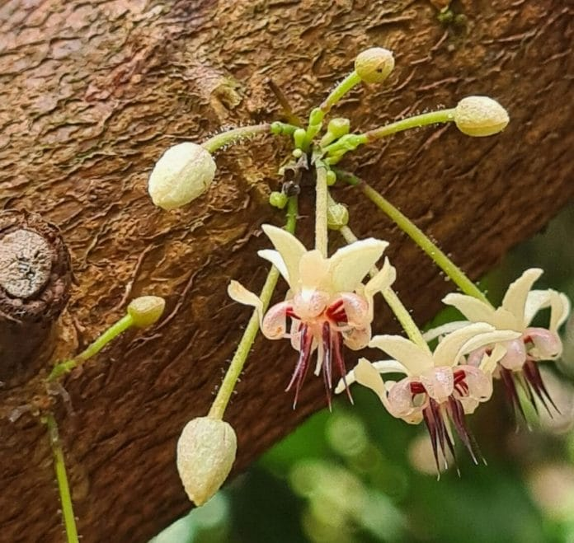
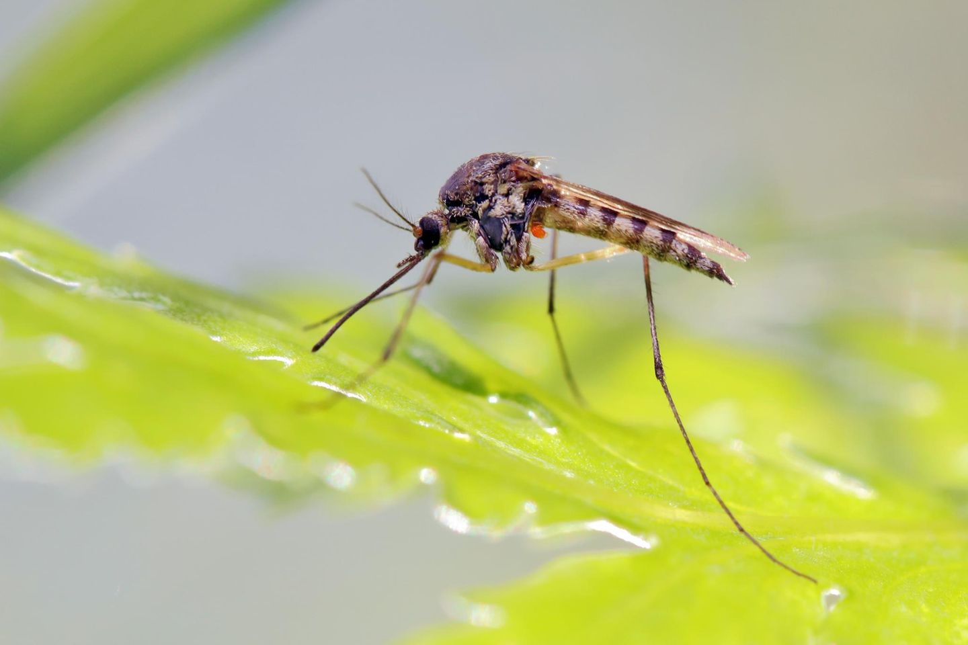

Slide 6

Twin Transformation- Digital & Sustainable
Primary skills
Shaping the digital transformation sustainable
Digitalization of the sustainability transformation
Viewed from the inside out
Viewed from the outside
Support-Options
Source: The Twin Transformation Butterfly
Notes:
Blick von Innen nach außen:
Einführung von z.B.:
Cloud Computing
Big Data
IoT/ Industrie 4.0
As a service
zur Förderung von Effizienz und Innovation
Blick von außen nach innen: Umweltfreundliche und sozial verantwortliche Geschäftsmodelle z.B durch:
Vorhersagemodelle
Green Digital Twin
Energiemanagement
Digitale Plattformen für Kreislaufwirtschaft

Slide 7

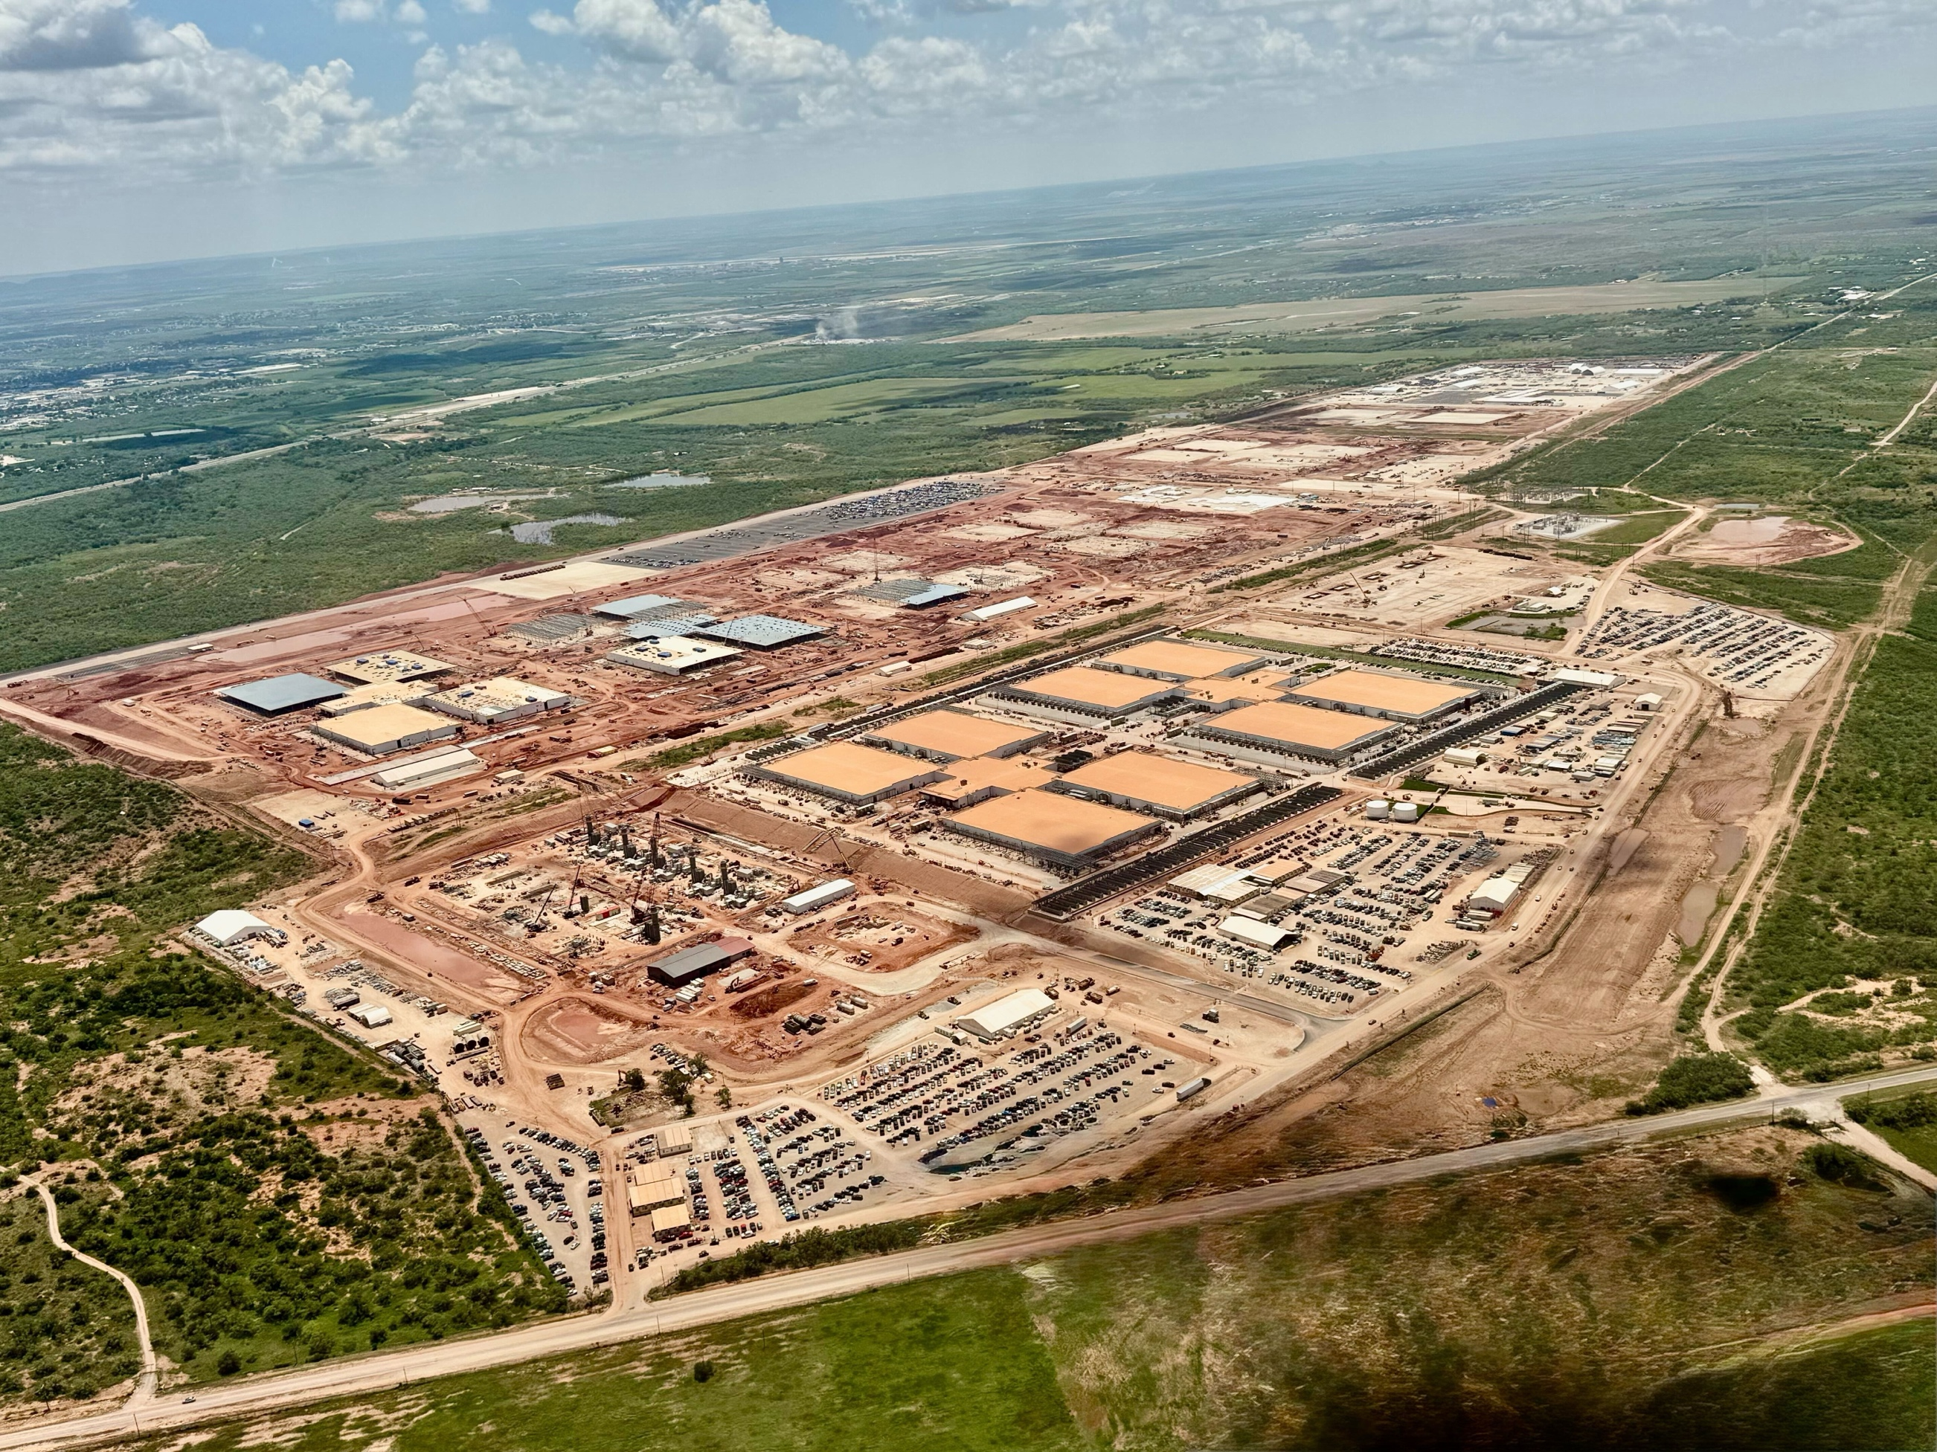
A backpack full of (environmental) influences
OpenAI Stargate – 5GW (43,8 TWh)at start, 10GW (87,6 TWh) full swing –
corresponds to annual consumption of one to two medium-sized EU countries such as Portugal, Greece or Austria.

Slide 8

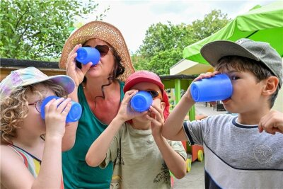
Data centres compete with us for water and energy
2023 - Chat GPT-3:
10–50 Prompts = 0,5 Liter water 2024 - Chat GPT-4:
A single prompt = 0,5 Liter water
2025 – Chat GPT-5: ?

Slide 9
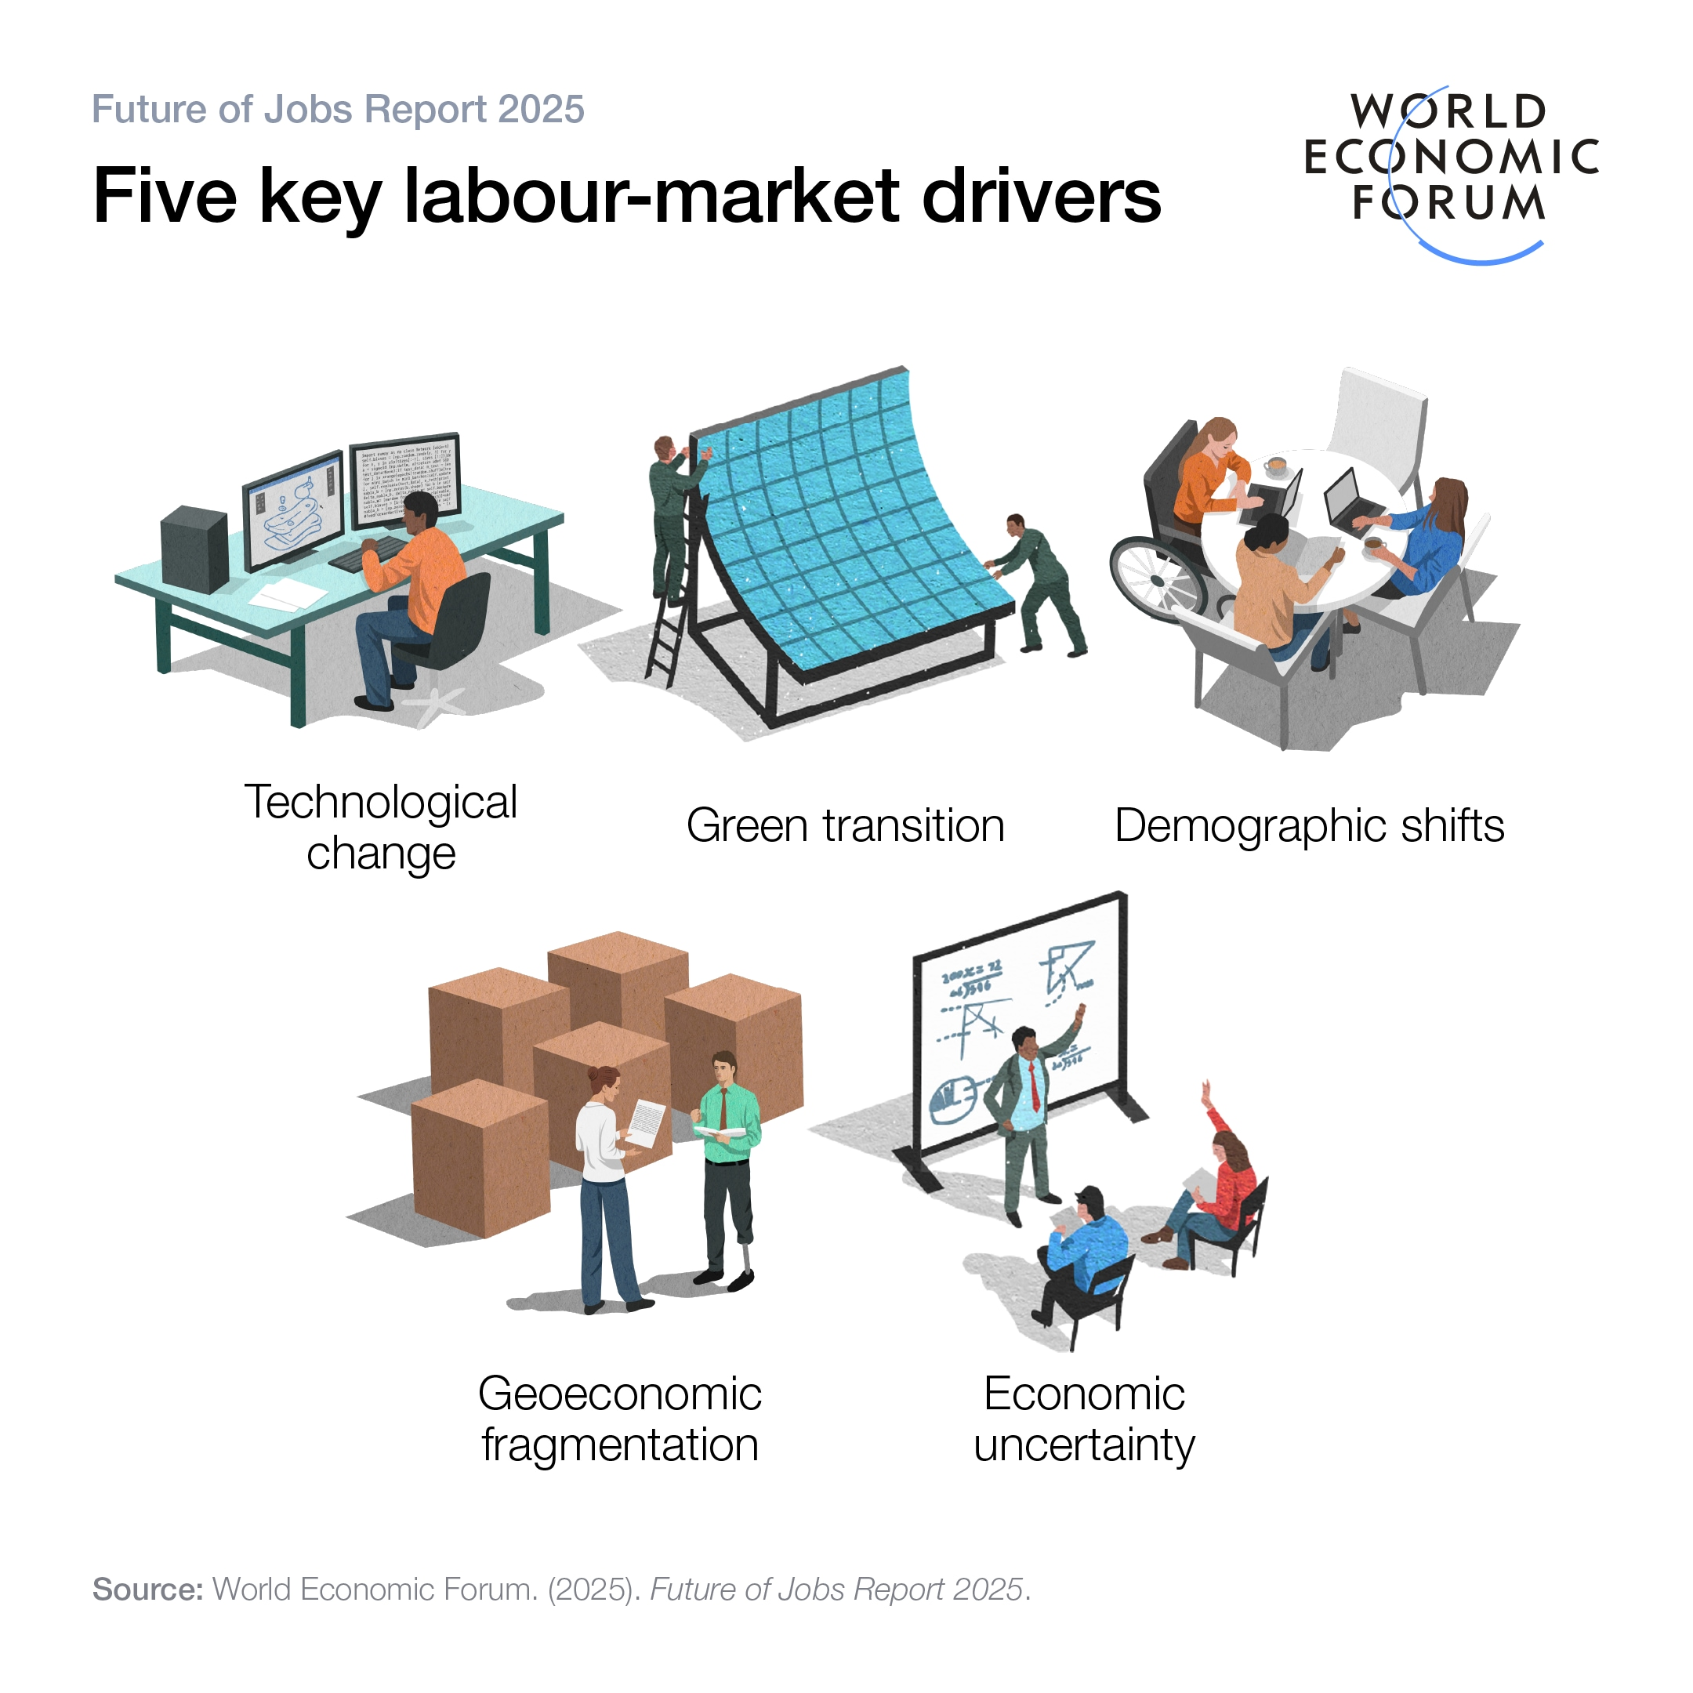
The future of jobs

Slide 10
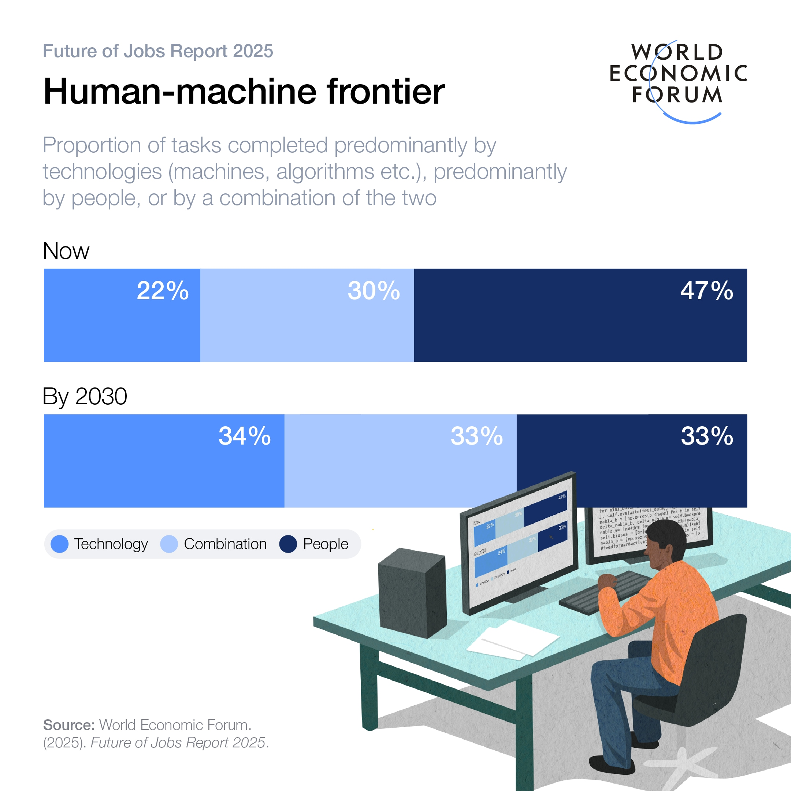
The thesis: In the next 5 years, millions of people will lose their jobs to AI
Accounting
Customer Service
Transport and Logistics
Data Analysts
Coders & Programmers
Standardised manual tasks

Slide 11

Identifying the Real Bottleneck: The Competence Gap
No lack of tools, but a lack of skills. IT training curricula & programs need an update

Slide 12

NABIT: Education as Enabler
Sustainable Education in IT Training and professional development: A research project designed to bridge the competence gap. Our Goal:
sustainability skills in IT
modular learning formats
consulting concepts

Slide 13


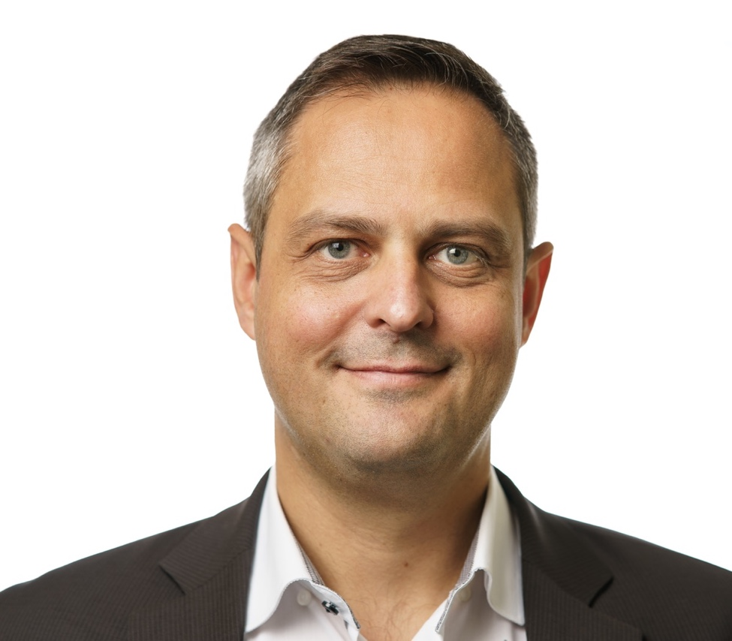
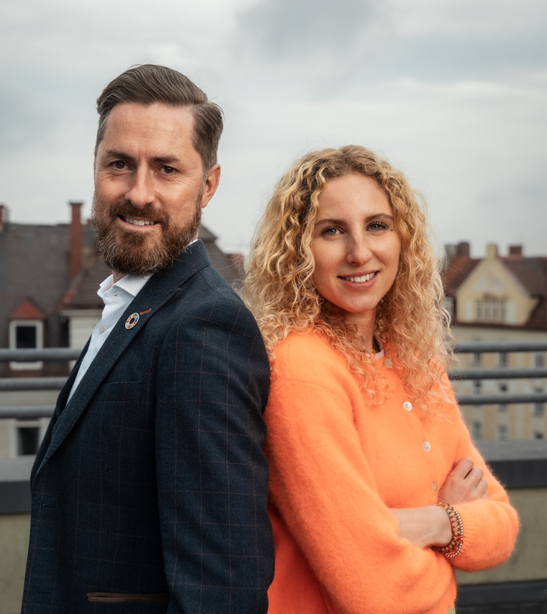
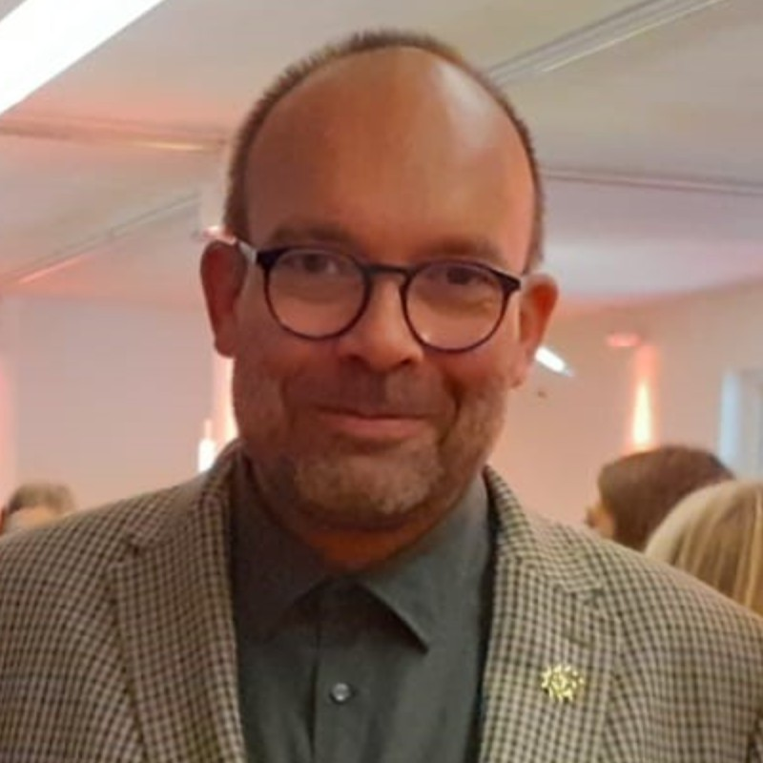

NABIT: Collaboration for the good
Project from 01/2026- 12/2028

Slide 14
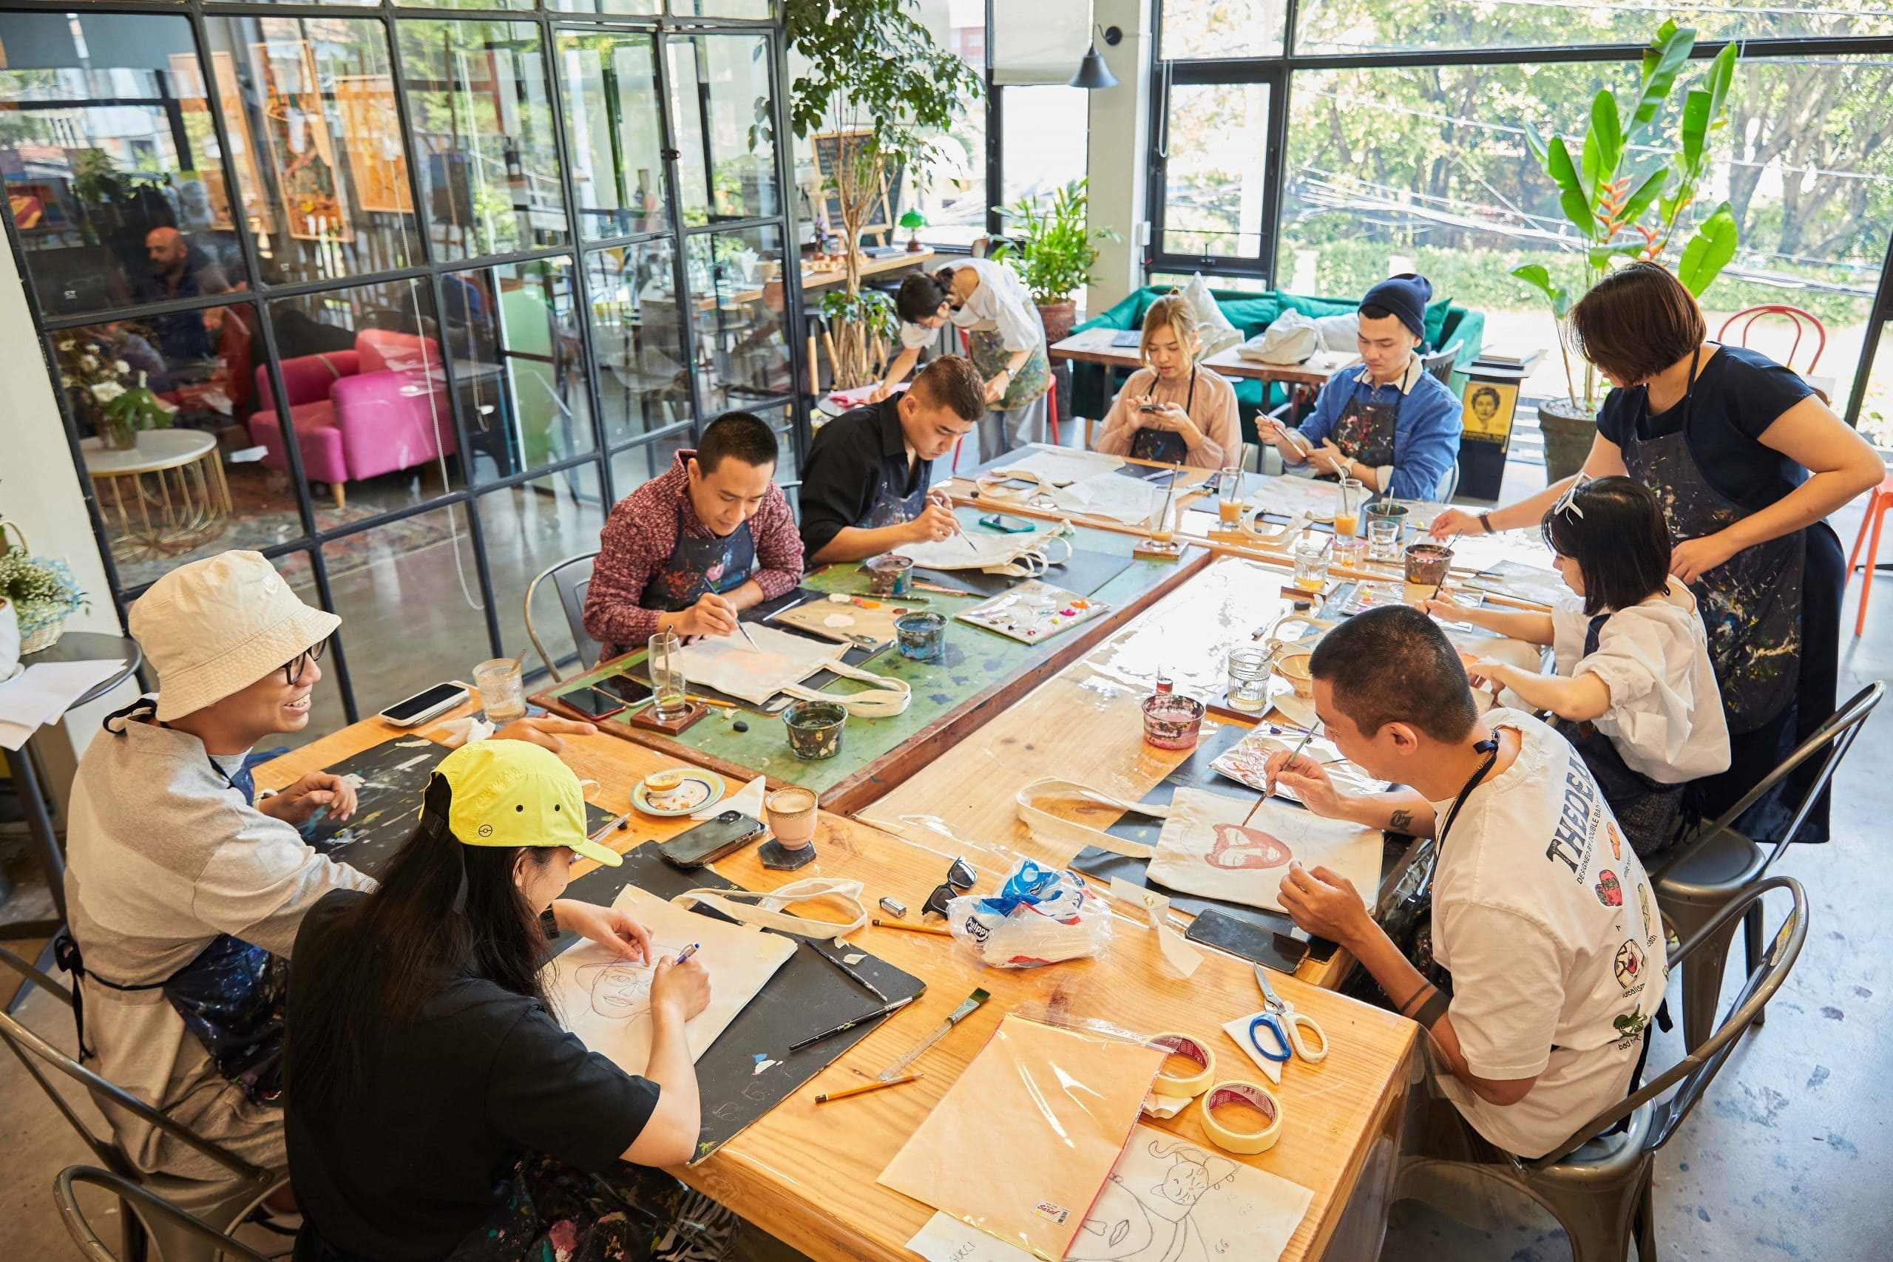

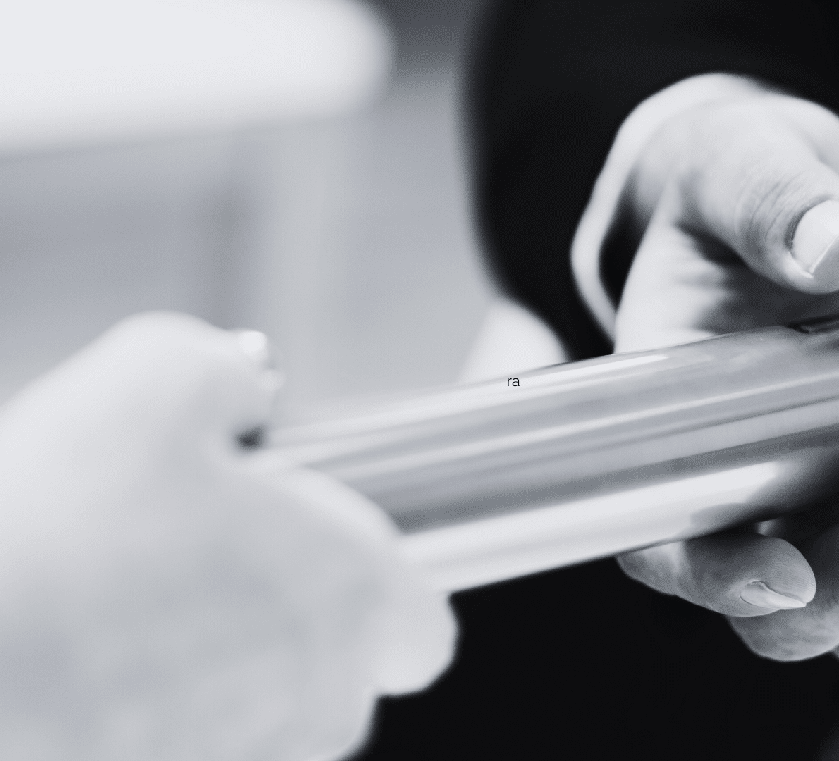
Theoretical & Practical Solutions:
Analysis
Development
Transfer

Slide 15

Why this matters to you
For Developers & Architects:
Understand
Learn
Build
For Decision-Makers & Data Center Professionals:
Realize
Skill development
Sustainable infrastructure
For the ecoCompute Community:
Social and Educational Dimension
Bridge to the "Community Track"
Focusing on people, justice, and governance

Slide 16

Digital sovereignty to defend democratic values or why education ensures future viability

Slide 17
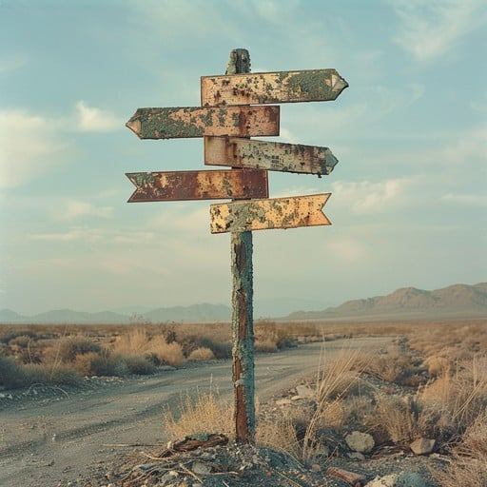
Twin Transformation
Skill Gaps
Learning environment
Change in SME
Well- Being-
Society
Democratic values

Slide 18
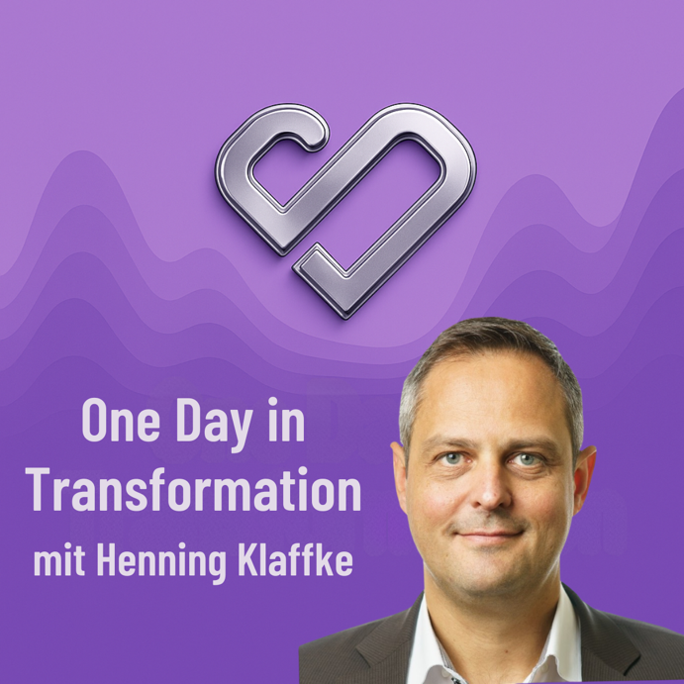


The future does not just happen. It is created by us. A fair future for all is our shared responsibility.
Rainer Karcher
Henning Klaffke
Heartprint GmbH
Founder & CEO
SustainableIT.org Chief Sustainability Officer
Berufliche Hochschule Hamburg Prof. Applied Computer Science Education Enthusiast
THE podcast about transformation
rainer@heartprint.eu
henning.klaffke@bhh.hamburg.de
https://www.linkedin.com/in/rainerkarcher/
https://www.linkedin.com/in/prof-dr-henning-klaffke/

